Slide 1
Navigating Hard Conversations with Managers, Peers, and Direct Reports
Presented by Gail Fann Thomas, EdD
May 30, 2024

Slide 2

Before We Get Started
Webinar is being recorded
Slides will be sent out, along with resources
Submit questions at any time using the Q&A
Feel free to use the chat to share what you’re thinking throughout the webinar

Slide 3

Gail Fann Thomas, EdD
Educator, author, consultant, executive coach
Taught graduate management and executive education at the Naval Postgraduate School in Monterey, CA for more than 30 years
Specializes in communication, building collaborative capacity, conflict management, and team development
Currently working with private sector organizations and several federal agencies
Published more than 60 academic articles, chapters and technical reports; co-author TKI Team Report (2022)
Lives in Monterey, CA

Slide 4

Poll
What’s your experience helping others navigate hard conversations at work?
I train, coach, facilitate, or consult with individuals or teams about hard conversations.
I am a manager, CEO, or HR director who approves or manages programs about hard conversations for my organization.
Other (please specify in chat box)

Slide 5
Agenda
Hard Conversations and Relationship to Conflict
Definitions of hard conversations and conflict
Goal of hard conversations
Triggers for managers, co-workers, and direct reports
Threats that make conversations hard
A Process Model for Hard Conversations
What happens when one’s views differ from another’s
Analysis and assessment of constructive and destructive conversations using the process model
Diagnostics to Assess Employees’ Ability to Handle Hard Conversations
Self awareness, perceptions of others, and situational factors
Cognitive frame and emotional responses
Conflict-handling preferences
Behavior and others’ reactions
Helpful Skills for Improving Ability to Engage in Hard Conversations
Identify type of conflict that might underlie a hard conversation
Managing emotions
Building core soft skills that enable productive hard conversations

Slide 6


A POPULAR TOPIC!
Difficult conversations
Crucial conversations
Fierce conversations
Radical candor
HARD CONVERSATIONS

Slide 7

The research is clear
Complex problems require different viewpoints
Notes:
internal and external stakeholders to share different viewpoints toward the solution of a complex problem.

Slide 8
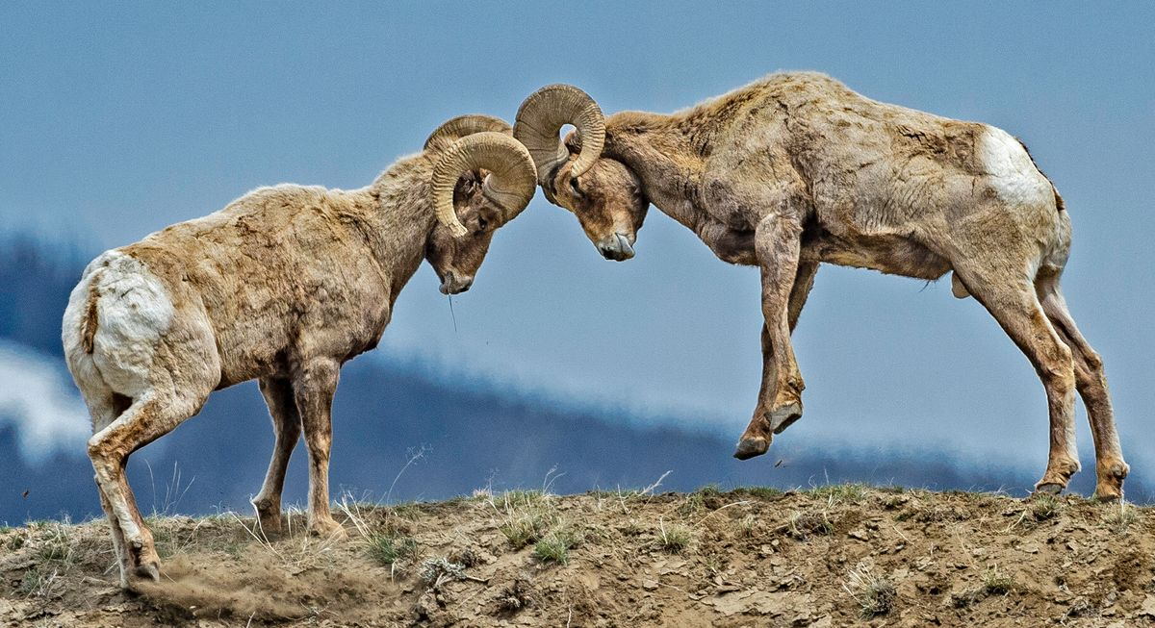
But different viewpoints often call for hard conversations

Slide 9

Definition of Hard Conversations
Uneasy discussions between organizational members who care about an issue, have different perspectives, and may experience strong emotions.
Hard conversations can occur with direct reports, co-workers, managers, or external constituents.

Slide 10

Definition of Conflict
Conflict occurs when people’s concerns, or the things they care about, appear to be incompatible.
Conflict can be either destructive or constructive – depending on how it is handled.
Source: Thomas, K.W. Introduction to Conflict Management, 2002

Slide 11

The goal of a hard conversation is to be able to:
share different perspectives
build mutual understanding
manage one’s emotions
foster respect and
cultivate positive relationships

Slide 12

What issues might trigger hard conversations between managers and their direct reports? (participant responses)
Accountability
Attendance
Conflicting priorities
Communication
Different leadership styles
Future layoffs
Lack of trust
Missed deadlines
Performance issues
Resources
Time management
Unclear expectations

Slide 13
What issues might trigger hard conversations among co-workers? (participant responses)
Accountability
Cell phone use
Change issues
Communication
Cultural misunderstandings
Deadlines
Differences of opinion
Differing expectations
Difference in management style
Difference visions
Different work ethics
Incompetence
Lack of integrity
Lack of role clarity
Lack of training
Overtime
Personality differences
Personality differences
Process issues
Scope changes
Taking credit for your work
Time pressures
Unclear goals
Unprofessionalism
Willingness to speak up
Workforce reduction

Slide 14

What issues might trigger hard conversations with external constituents? (participant responses)
Accountability
Late deliverables
Level of service
Misunderstanding of roles
Not meeting deadlines
Over promise/underdeliver
Reliability
Scope changes
Unclear expectations
Unrealistic expectations

Slide 15
Which conversations are the most difficult?
(POLL)
Direct reports and their managers (upward)
Managers and their direct reports (downward)
Co-workers
Individuals outside the organization (e.g. vendors, partners)

Slide 16

What makes these conversations so hard?
(What’s the threat?) (participant responses)
Damaging the relationship
Discomfort with tension
Fear of getting sued
Fear of judgement
Fear of harassment charges
Fear of losing job
Fear of making things worse
Fear of quiet quitting
Fear of upsetting another
Hostility
Lack of skill
No authority
Power dynamics
Retaliation
Notes:
Uncertain reactions: Not knowing how the other person will react
Sensitive topics: Discussing difficult or sensitive subjects
Uncooperative perception: Being perceived as uncooperative
Emotions: Strong emotions like fear, anger, and frustration can make conversations heated
Inadequate communication skills: Not listening actively or making assumptions

Slide 17
Agenda
Hard Conversations and Relationship to Conflict
Definitions of hard conversations and conflict
Goal of hard conversations
Triggers for managers, co-workers, and direct reports
Threats that make conversations hard
A Process Model for Hard Conversations
What happens when one’s views differ from another’s
Analysis and assessment of constructive and destructive conversations using the process model
Diagnostics to Assess Employees’ Ability to Handle Hard Conversations
Self awareness, perceptions of others, and situational factors
Cognitive frame and emotional responses
Conflict-handling preferences
Behavior and others’ reactions
Helpful Skills for Improving Ability to Engage in Hard Conversations
Identify type of conflict that might underlie a hard conversation
Managing emotions
Building core soft skills that enable productive hard conversations

Slide 18
The Process Model
What happens when one’s views differ from another’s?
POSSIBLE APPROACHES
YOU
SENSEMAKING
BEHAVIOR
OUTCOME
Personal characteristics
Past experiences
Compete
Collaborate
Compromise
Avoid
Accommodate
Overt behavior and other’s reaction
Constructive or Destructive
Conversation
Cognitive
(thinking)
Cognitive (thinking)
HOW YOU SEE OTHERS
Interpretation of other’s behavior
Attribution of motives
Assessment of threat
Emotional (feeling)
Emotional
(feeling)
SITUATION
Organization influences
Source: Adapted from Robbins, S.P. Essentials of Organizational Behavior (1994)

Slide 19
Agenda
Hard Conversations and Relationship to Conflict
Definitions of hard conversations and conflict
Goal of hard conversations
Triggers for managers, co-workers, and direct reports
Threats that make conversations hard
A Process Model for Hard Conversations
What happens when one’s views differ from another’s
Analysis and assessment of constructive and destructive conversations using the process model
Diagnostics to Assess Employees’ Ability to Handle Hard Conversations
Self awareness, perceptions of others, and situational factors
Cognitive frame and emotional responses
Conflict-handling preferences
Behavior and others’ reactions
Helpful Skills for Improving Ability to Engage in Hard Conversations
Identify type of conflict that might underlie a hard conversation
Managing emotions
Building core soft skills that enable productive hard conversations

Slide 20

How self aware are your employees/clients?
You and how you see others
  What makes a conversation “hard” for them?
  How tolerant are they with discord? (intensity)
  What is their past experience with hard conversations?
  What triggers hard conversations for them? (values and unmet needs)
  How does their perception of the other contribute to the hard conversation?
  What threats cause the most anxiety for them? (e.g. fear of retribution, reputation)

Slide 21
What situational factors might be contributing to hard conversations in their workplace?
Situational factors
Do members experience psychological safety in their team, department, or organization?
How much trust exists in the organization?
Does their organization value collaboration or is there a win/lose culture?
Are members encouraged and trained to share their needs and concerns?

Slide 22
How do they make sense of hard conversations?
Sensemaking
Can they separate the facts, interpretation of the facts, and their evaluation of the situation?
What frames are they using to interpret the situation?
Are they able to invent alternative interpretations of the same situation?
Can they articulate the emotions associated with the hard conversation?
Do they know what unmet needs might be at play and the relationship to their emotions?

Slide 23
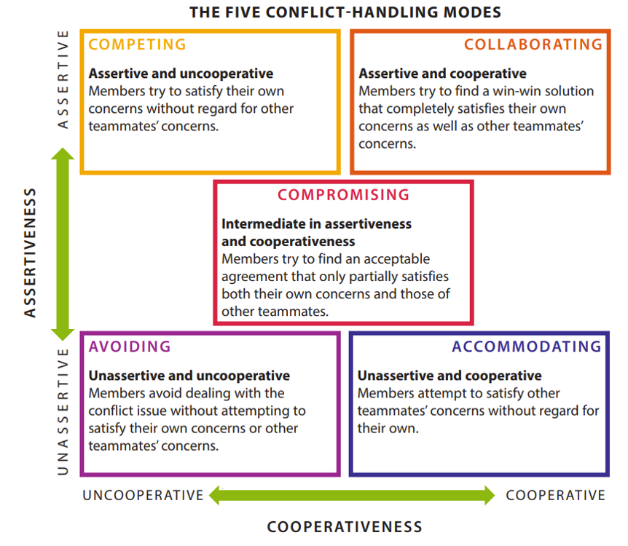
Approaches
What approaches are used to handle conflict?
Individuals generally have (often unconscious) patterns of responses when they are faced with hard conversations or conflicting viewpoints.
CONCERN FOR SELF
When faced with a hard conversation, individuals often avoid or accommodate.
Source: K. Thomas, Introduction to Conflict Management, 2002
CONCERN FOR OTHERS

Slide 24
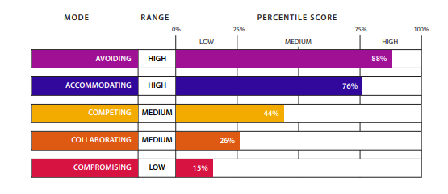
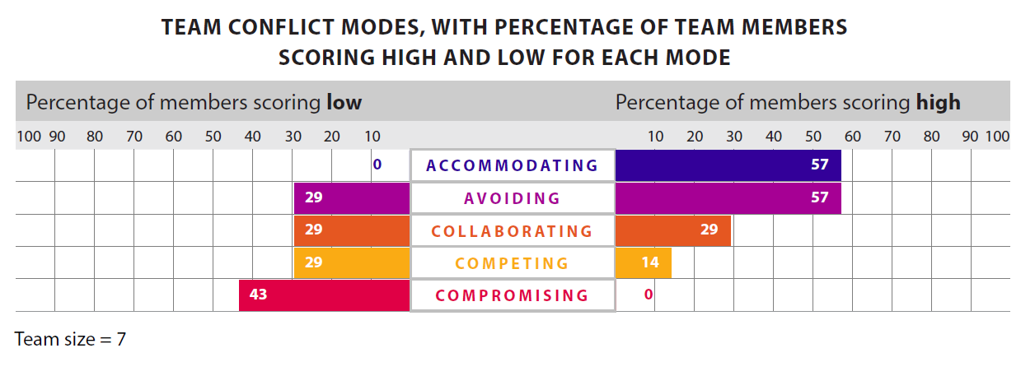
The TKI assesses individual and team conflict-handling approaches
Approaches
Individual profile
Team profile
Thomas-Kilmann Conflict-Handling Instrument (TKI)
Myers-Briggs Company

Slide 25
Other assessment tools related to an ability to engage in hard conversations
Approaches
Myers-Briggs Type Indicator® (MBTI ®)
FIRO-B ®
Emotional intelligence assessments
Psychological safety inventory (Edmondson, 2019)
Communication styles inventory (Goulston, 2015)

Slide 26

Have they assessed their behavior and reactions to others during a hard conversation?
Behavior
Do they know their behavior patterns?
Have they tracked and analyzed their behavior and reactions to others during hard conversations?
  Journaling
  Feedback from others
  Role plays/simulations
Does their behavior match their intentions?

Slide 27
Agenda
Hard Conversations and Relationship to Conflict
Definitions of hard conversations and conflict
Goal of hard conversations
Triggers for managers, co-workers, and direct reports
Threats that make conversations hard
A Process Model for Hard Conversations
What happens when one’s views differ from another’s
Analysis and assessment of constructive and destructive conversations using the process model
Diagnostics to Assess Employees’ Ability to Handle Hard Conversations
Self awareness, perceptions of others, and situational factors
Cognitive frame and emotional responses
Conflict-handling preferences
Behavior and others’ reactions
Helpful Skills for Improving Ability to Engage in Hard Conversations
Identify type of conflict that might underlie a hard conversation
Managing emotions
Building core soft skills that enable productive hard conversations

Slide 28
Identify type of conflict that might underlie a hard conversation
Process conflict focuses on how the team’s work will be accomplished How will we make decisions? How often shall we meet?
Relationship conflicts are disagreements and personality clashes between team members. Often results in tensions and resentments Dislike between group members Differences in values
Task conflicts are differences about substantive or content issues Difference in problem identification Different perspectives on solutions
Source: Jehn & Mannix, 2001

Slide 29
Identify Emotions and Unmet Needs
Articulate feelings (examples)
Identify unmet needs (examples)
Angry
Annoyed
Anxious
Discouraged
Embarrassed
Impatient
Irritated
Overwhelmed
Connection
Understanding
Autonomy
Belonging
Trust
Purpose
Learning
Competence
Source: Rosenberg,M.B. Non-violent communication, 2004.

Slide 30

Build These Core Soft Skills
Setting ground rules to create a safe space
Finding common ground
Using active listening
Identifying concerns for all parties
Employing empathy
Perspective-taking
Applying effective problem solving
Decreasing defensiveness (e.g. use “I” statements)

Slide 31
Using “I” Statements
“You” statements tend to increase defensiveness
  “You always interrupt me which makes me angry.”
“I” statements show how the situation looks from your perspective, can help reduce blame, and open the door for more constructive conversation.
  “At our last department meeting, I was interrupted several times which made me very frustrated, then angry. When I’m interrupted, I feel disrespected and feel like my ideas aren’t valued. Next time we meet, can we set some ground rules to make sure that people don’t talk over one another?”
Notes:
Note identification of feelings linked to unmet needs

Slide 32
Hard conversations – what to do before, during, and after
BEFORE
develop your skill set, anticipate hard conversations, be clear on your goals, prepare for the interaction
DURING
create psychological safety, watch for triggers, manage your emotions, deescalate, call for a time out if needed, steer conversation toward constructive problem solving
AFTER
hotwash, develop lessons learned for hard conversations that were avoided and conversations that turned from destructive to constructive

Slide 33
Keys for Managing Hard Conversations
With your manager
With co-workers
With direct reports
Understand yourself
Understand your manager
  Concerns
  Pressures
  Communication style
  Strengths
  Weaknesses/
  challenges
Identify inter- dependencies
  Clarify roles and responsibilities
Focus on the task rather than the person
Create psychological safety
Use active listening
Engage in perspective taking

Slide 34
Hard Conversations
Coaching Prompts
In general, how would you rate your ability to engage in hard conversations that have positive outcomes for yourself and the other?
  I tend to avoid hard conversations whenever possible
  Poor – problems are rarely resolved satisfactorily, and the relationship with the other worsens
  Fair – we generally reach a satisfactory solution to the problem OR the relationship improves
  Excellent – we generally can reach satisfactory solutions AND our relationship improves
What generally triggers a hard conversation for you? (values, needs)
What makes a conversation hard for you? (threats)
How would you rate your skills in the following areas? How would others rate your skills? (1=Much improvement needed; 5=Excellent)
  Active listening
  Identifying concerns
  Employing empathy
  Being open minded
  Decreasing defensiveness
  Perspective taking
  Effective problem solving
Professional development plan. Chose one or two areas to improve upon in the next 6 months. What’s your plan? How will you hold yourself accountable?

Slide 35
Questions?
Insights?

Slide 36
Podcast, Webinars, Team Conflict Assessment
Podcast:
Conflict management podcast with Dr. Gail Fann Thomas | The Myers-Briggs Company (themyersbriggs.com)
Webinars for individual and team conflict:
Developing Teams Using the TKI Team Report| The Myers-Briggs Company (themyersbriggs.com)
Managing Conflict for Three Types of Teams| The Myers-Briggs Company (themyersbriggs.com)
Navigating Change in the Public Sector: How to Leverage Conflict for Success (themyersbriggs.com)
TKI conflict assessment:
Thomas-Kilmann Conflict Mode Instrument Individual Interpretive Report.
https://www.themyersbriggs.com/tki
Thomas-Kilmann Conflict Mode Instrument Team Report and Facilitator’s Guide. https://www.themyersbriggs.com/en-US/Connect-with-us/Blog/2022/October/The-New-TKI-Team-Report

Slide 37
Suggested Reading
Edmondson, A.C. (2018). The Fearless Organization: Creating Psychological Safety. Wiley.
Edmondson, A.C. & Smith, D.M. (2006). Too hot to handle? How to manage relationship conflict. California Management Review, Fall, 6-31.
Goulston, M. (2015). Assessment: How well do you communicate during conflict? Harvard Business Review.
Krueger, K.L., Diabes, M.S., and Weingart, L.R. (2022). The psychological experience of intragroup conflict. Research in Organizational Behavior, 42.
Peterson, R. (2023). Understanding the ladder of inference. USC Gould School of Law.
Rosenberg, M. (2015). Nonviolent Communication: Tools for Healthy Relationships
Thomas, K.W. (2002). Introduction to conflict management: Improving performance using the TKI. The Myers-Briggs Company.

Slide 38
BACKUP SLIDES

Slide 39
Develop skills for managing three types of conflict
Type of Conflict | Focus | Skills
Process | Tools and Techniques | Be clear on purpose, goal, and desired outcomes Use check-ins Establish timelines Learn a variety of process techniques: consensus decision making, nominal group technique, dialectic inquiry Techniques for soliciting all voices
Interpersonal | Emotional intelligence | Establish clear roles and responsibilities Set behavioral standards and abide by them Be self aware Practice empathy Listen actively See also “Too Hot to Handle”
Task | Problem solving | Problem identification Identify stakeholders’ interests Be firm on interests, flexible on position Listen actively Identify possible solutions Integrate best solutions Check progress and adapt

Slide 40
Effective use of the five conflict-handling modes
 | Definition | When | Effective Use | Misuse
Competing Assertive Uncooperative | Someone who stands up for their own position. Defends a decision that seems correct. Focus is on winning. | The decision is very important to you - Sustaining relationships is not important - You are not concerned with others’ input - You need to implement unpopular courses of action - Quick, decisive action is needed | Be persuasive Fight fair Use warnings, not threats Impose a decision Use tough love | Not listening: interrupting, talking over, or ignoring others’ statements Attacking: showing anger; making personal criticisms or threats
Collaborating Assertive Cooperative | Works with others to find a solution that satisfies the concerns of all parties. | The decision is important to all - Issues are non-routine / complex - You want to gain commitment from all players - You want to understand what’s driving others’ positions - You have time to discuss | Set the right tone Identify underlying concerns State as a mutual problem Brainstorm solutions, find best Use firm flexibility Collaborate in groups | Overanalyzing: problem solving when the answer is clear or the issue is unimportant Flailing: continuing to problem solve when it’s not working
Compromising Partially assertive Partially cooperative | Finds a mutually acceptable solution. Splitting the difference. | The decision is simple or moderately important - Two players have equal power - Goals are mutually exclusive - You want to reach a temporary settlement on an issue - Collaborating or competing modes don’t work - There is a little time to discuss | To move away from competing Focus on fairness | Posturing: using misrepresentation or inflated demands to get a favorable settlement Settling short: agreeing to a compromise that does not meet team needs
Avoiding Unassertive Uncooperative | Sidesteps or postpones the issue. | Both parties believe the decision is not very important - You can postpone a decision to a better time - There is little or no time to engage | Decide what’s important Avoid without being evasive Break an anger cycle | Avoiding teammates: avoiding individuals with whom you have issues; not returning e-mails, calls, etc. Withholding information: not volunteering information on issues; providing vague answers
Accommodating Unassertive Cooperative | Satisfies the concerns of the other party. Yields to another point of view. | The decision is important to the other party and not to you - The parties are particularly concerned about maintaining relationships that have been strained - There is little time for discussion | Concede gracefully Plant seeds Satisfy complaints | Allowing questionable decisions: not challenging decisions you have doubts about; not “rocking the boat” Bending rules: allowing exceptions to rules or standards; overlooking violations or substandard performance
Source: K. Thomas, Introduction to Conflict Management, Myers-Briggs

Slide 41
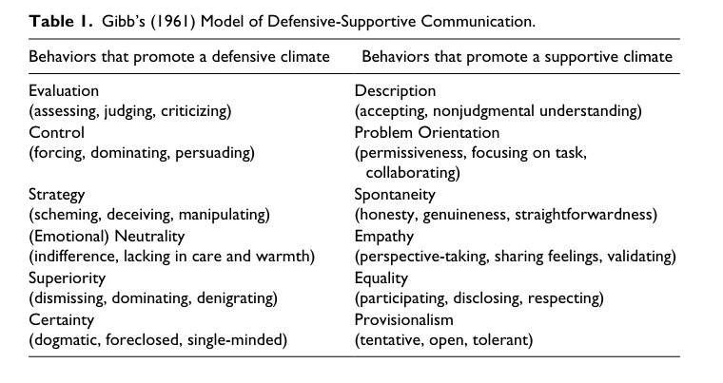
Model of Defensive-Supportive Communication

Slide 42
Best Practices for Managing “Hot” Interpersonal Conflict
PRACTICE | ACTIONS | BEHAVIORS
Managing self | Reflect | Observe your emotional reactions Identify your interpretations of others’ intentions Explore what your interpretation might say about you
 | Reframe | Invent alternative interpretations Consider why you might be missing what others’ see Extend to others the same rights you claim for yourself
Managing conversations | Dig into divisive topics | Treat people’s concerns and interest as legitimate topics of conversation Make your reactions public. State your concerns, beliefs, and data that shape your views and ask others to do the same Acknowledge any puzzles or “binds” that you experience. Invite others to help you address them.
 | Examine competing views | Explore competing beliefs, relying on data everyone (not just you) considers valid. Ask others what they are feeling and thinking and what leads them to feel/think that way Examine how different team members’ interests relate to the interests of the team
Managing relationships | Build grounded trust | Build grounded trust – trust based on recognition of each person’s assets and liabilities Maintain the right to make mistakes and extend the same right to others Assume responsibility for learning from mistakes and help others on the team do to the same
 | Target key relationships | Target for investment those relationships operating along organizational failures Map patterns of interactions that affect the team’s ability to make decisions together Use conflicts to alter those dynamics that undermine the team’s effectiveness
Source: Edmondson & Smith Too Hot to Handle?
California Management Review Fall 2006

Slide 43

Contact information for Gail Fann Thomas, EdD
https://www.linkedin.com/in/gail-fann-thomas-12a7b723/
gailfannthomas53@gmail.com

