Slide 1
ASK AN EXPERT
How to Make Conflict Work for Teams
Presented by Gail Fann Thomas, EdD
02 May 2023

Slide 2
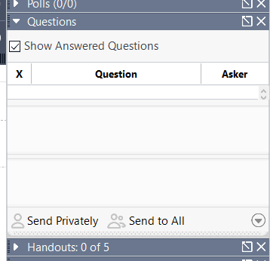
Before We Get Started
Webinar is being recorded
Slides will be sent out, along with resources
Submit questions at any time using the questions box
Feel free to use the questions box to share what you’re thinking throughout the webinar

Slide 3
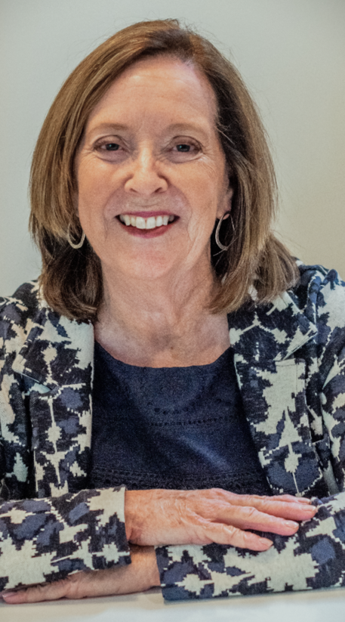
Gail Fann Thomas, EdD
Educator, author, consultant, executive coach
Taught graduate management and executive education at the Naval Postgraduate School in Monterey, CA for more than 30 years
Specializes in communication, building collaborative capacity, conflict management, and team development
Currently working with private sector organizations and several federal and state agencies
Published more than 60 academic articles, chapters and technical reports; co-author TKI Team Report (2022)
Lives in Monterey, CA

Slide 4
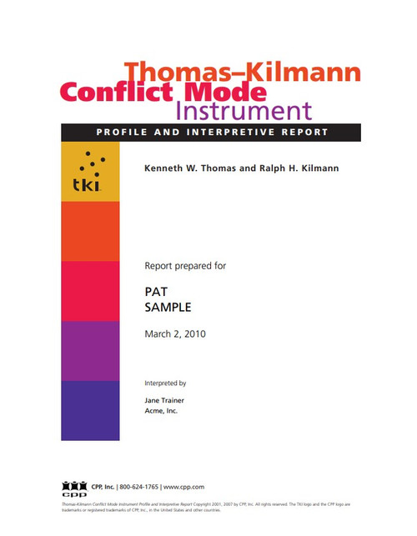
Poll
What’s your experience using the TKI assessment tool?
I use the TKI predominantly with individuals
I use the TKI with individuals AND teams
I use the TKI infrequently
I have never used the TKI

Slide 5
Open-ended question – examples of team conflict
Think about a team
  current or past
  where you are/were a member
  that you are/were serving as a consultant
Please write in the chat box, a conflict that the team is/was dealing with
Example: For a small municipality, the board and managers disagree on an employee compensation scheme

Slide 6
Ask an expert overview
Questions and answers we’ll address today:
How can conflict improve team performance?
What are the best approaches for improving conflict management skills for teams?
What’s the best use of the TKI interpretive report and TKI Team Report?
Are conflict handling skills different for remote, hybrid, and face-to-face teams?
As a team member, can I change my conflict-handling preferences?
What’s new about conflict and teams?

Slide 7
More questions and answers…….
Are there generational difference in conflict-handling skills?
How do I address conflict with my boss?
How do team members deal with a bullying environment?
What questions and insights do you have?

Slide 8
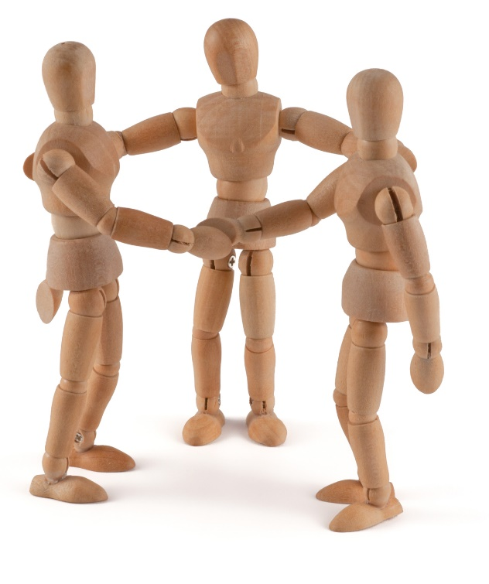
AAE Question
How can conflict improve team performance?

Slide 9

“Disagreement [conflict] is key to refining ideas, identifying mistakes, and growing a collective unit.”
Tsedal Neeley, Faculty & Research at Harvard Business School, author of The Remote Work Revolution, 2021

Slide 10
Research shows that teams who excel at managing conflict are:
Better at surfacing input from diverse perspectives
Able to analyze alternative solutions more effectively
Better at making decisions
Able to improve morale and member retention
More satisfied with their team experience
Source: S. Tannenbaum & E. Salas, What Makes Teams Work: The Seven Drivers of Team Effectiveness, 2021

Slide 11

AAE Question
What are the best approaches for improving conflict management skills for team members?

Slide 12
Define, assess, and adapt
Be clear on what conflict is and is not
Become self-aware of conflict-handling preferences (low/high on assertiveness? low/high on cooperativeness?)
Determine what might be driving team members’ conflict-handling behavior (personality traits, role on the team, other team players’ roles and preferences, the situation)
Discuss with your teammates the modes that might be helpful at this time given the task
Practice improving skills on each of the five modes so that members aren’t overusing or underusing particular modes unconsciously
Get feedback from others to improve the team’s conflict management skills (in a psychologically safe environment)

Slide 13

Define conflict:
Conflict occurs when people’s concerns, or the things they care about, appear to be incompatible.
Conflict, itself, is neutral. It can be either destructive or constructive – depending on how it is handled.
We need to focus on quality!
We need to focus on cost!
Source: K. Thomas, Introduction to Team Conflict, 2002

Slide 14
Identify the three types of conflict that teams encounter
Process conflict focuses on how the team’s work will be accomplished How will we make decisions? How often shall we meet?
Relationship conflict are disagreements and personality clashes between team members. Often results in tensions and resentments Dislike between group members Differences in values
Task conflict are differences about substantive or content issues Difference in problem identification Different perspectives on solutions
Source: K.A. Jehn & E.A. Mannix, The Dynamic Nature of Conflict: A Longitudinal Study, AMJ, 2001

Slide 15
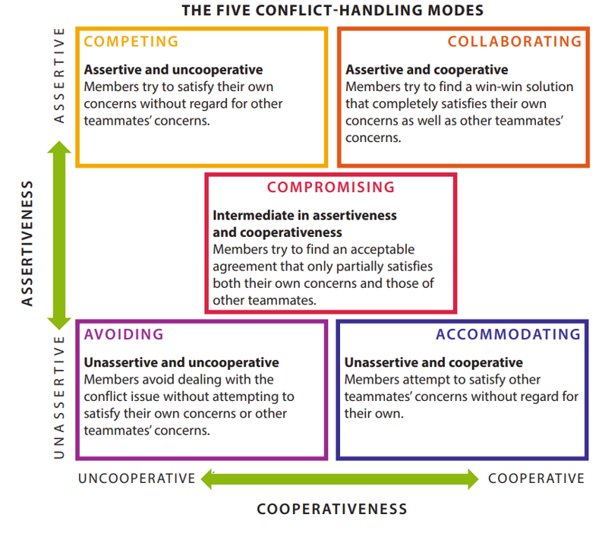
Know the five approaches to conflict handling
Source: K. Thomas, Introduction to Conflict Management, 2002

Slide 16
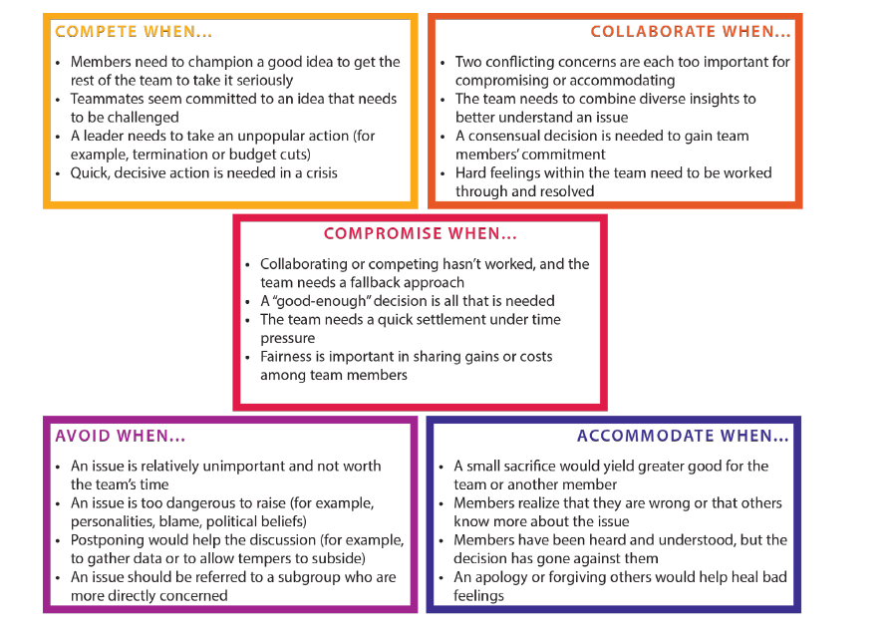
Assess the situation and know when to use each of the five conflict-handling modes
Source: K. Thomas, Introduction to Conflict Management, 2002

Slide 17
Updated TMBC research about approaches to conflict (compared to similar 2008 study)
2022 study scope and purpose:
  What causes conflict
  How well people believe they manage conflict
  The costs and consequences of conflict
  Who is responsible for management conflict
  The extent to which conflict is positive or negative
  How conflict makes people feel
  The role of the manager or supervisor during conflict
Source: Conflict at Work: A Research Report from The Myers-Briggs Company, August 2022

Slide 18

AAE Question
What’s the best use of the TKI interpretive report and TKI Team Report?

Slide 19
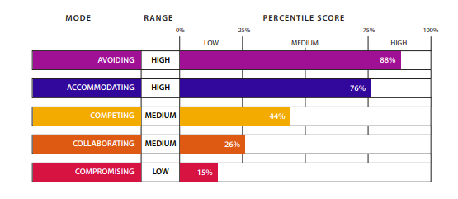
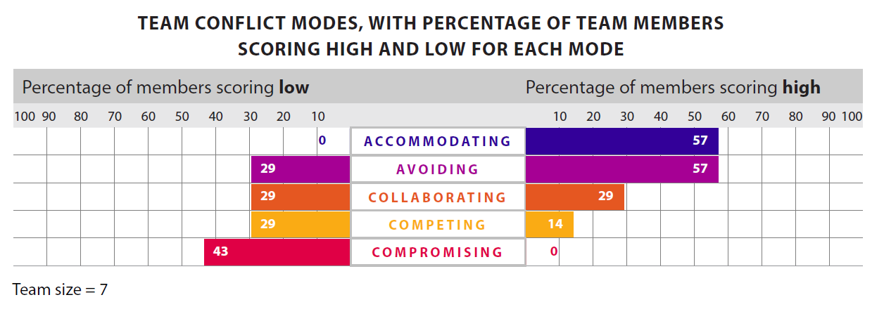
Know your preferences and your team members’ preferences
Individual profile for overuse and underuse of all modes
Team profile
for overuse and underuse of 5 modes
Source: TKI, Myers-Briggs Company

Slide 20
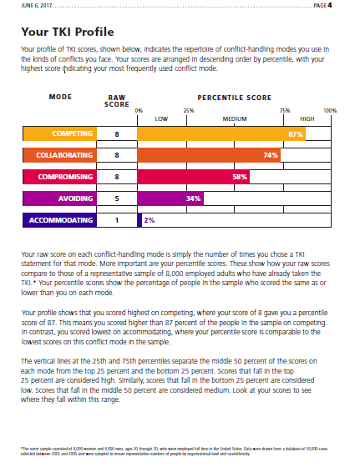
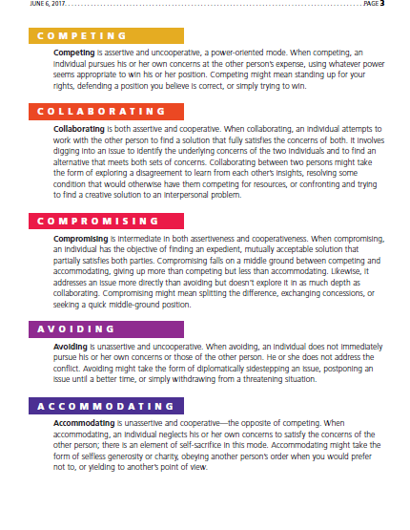
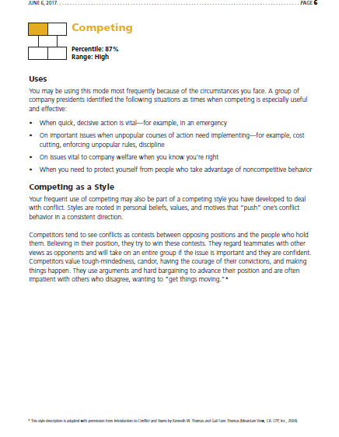
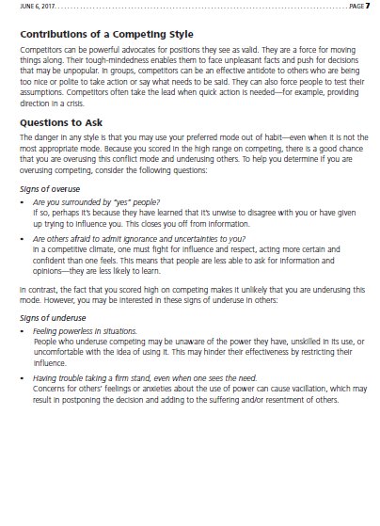
Take advantage of TKI reports and resources to improve conflict-handling behaviors
Notes:
Each mode is scored independently - ipsative scale – does not equal 100%
Each mode is normed separately
Designed to reduce social desirability

Slide 21

AAE Question
Are conflict-handling skills different for remote, hybrid, and face-to-face teams?

Slide 22
Conflict varies over time and by modality
 |  | Project Life Cycle
 |  | Beginning Point | Midpoint | Endpoint
Modality | Face-to-face
 | Hybrid
 | Fully remote
Implication: Use evidence-based interventions for team conflict based on life cycle stage and modality

Slide 23
Conflict differs for virtual workers
Type of Conflict | Virtual Work Considerations
Process | Time zones impact member availability Work hours need to be negotiated Collaborative technological tools are critical
Relationship | Interactions are mediated with technology Psychological trust is harder to develop Team cohesion requires more work
Task | Leader or other members may need to encourage productive conflict to improve outcomes Tools and procedures should be developed to optimize task conflict

Slide 24

AAE Question
As a team member, is it possible to change my conflict-handling preferences?

Slide 25
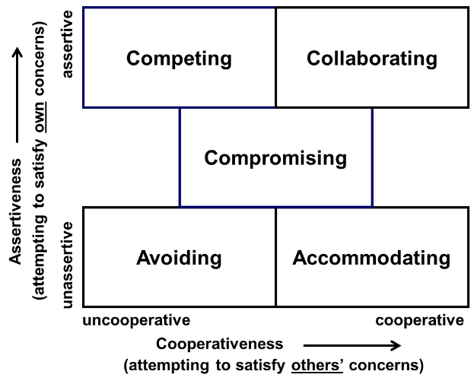
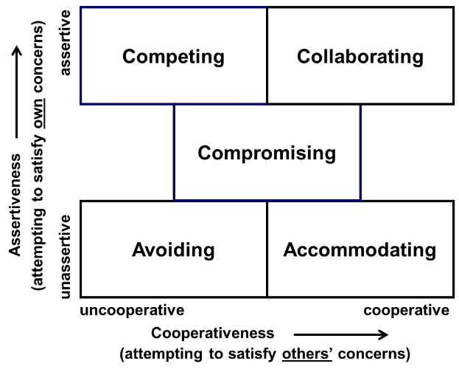
Analyze the pattern of your preferences
94
78
22
30
15
55
33
22
87
94
87
12
76
6
42
65
94
22
12
72

Slide 26
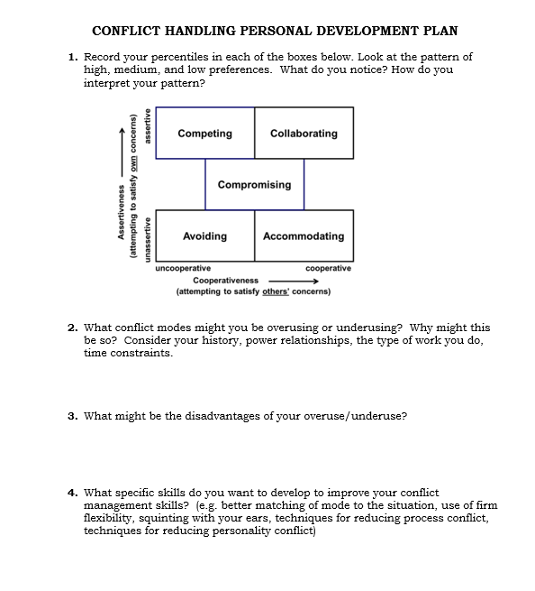

Conflict-handling personal development plan

Slide 27
AAE Question
What’s new about conflict and teams?

Slide 28
Previous way of thinking
about team conflict
Current research about
team conflict
Team conflict is stable
It’s uniform
It’s shared among all members (contagion effect)
Team conflict is dynamic
It’s variable among members
It’s not necessarily shared by all members
Implication: We need updated practices for training, coaching,
and assessing conflict in teams.

Slide 29
AAE Question
Are there generational differences in conflict-handling skills?
How might you manage intergenerational conflict?

Slide 30
Conflict management for Millennials, Gen X and Baby Boomers*
Conflict mode | Generational differences
Accommodating | Millennials more likely than Gen X and Baby Boomers
Avoiding | Gen X less likely, Baby Boomers more likely
Competing | Millennials more likely, Gen Xers more likely; Boomers less likely
Collaborating | Millennials less likely, Gen Xers less likely, Boomers more likely
Compromising | Gen Xers more likely; Boomers less likely
*Multi-method study, TKI data, 2006, 2012, 2018
Source: C.P. LeMay, Millennials and Conflict in the Workplace, 2023

Slide 31
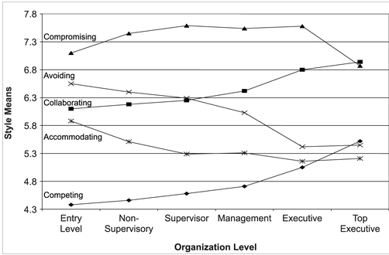
Conflict Handling Style Means and Organizational Level
Source: K.W. Thomas, G.F. Thomas, & N. Schaubhut, Conflict Styles of Men and Women, 2008

Slide 32
Consider differences in intrinsic motivation across the generations to manage intergenerational conflict
The Four Intrinsic Rewards (key to employee engagement)
  Sense of choice
  A sense of competence
  A sense of meaningfulness
  A sense of progress
Source: K. Thomas, Intrinsic Motivation at Work, 2009

Slide 33
AAE Question
How do I manage conflict with my boss?

Slide 34
Examples of conflict you might face with your boss
Resource allocation
Salary/bonuses
Roles and responsibilities
Communication methods
Policy implementation
Amount of personal information shared
Work/life boundaries
Amount and type of feedback provided

Slide 35
What makes it difficult to express disagreements with your boss?
Fear of retaliation
Managers’ insecurities
Managers’ apathy
Fear of intimidation
Hostile work environment
Lack of access to the boss
Fear of poor performance evaluations
Fear of job loss

Slide 36
Suggestions for managing conflict with your boss
(adjust based on level of trust and psychological safety)
Describe challenges to upward communication
Determine your boss’s and your goals, strengths, weaknesses, and personal styles
  conflict-handling preferences, communication styles, pressures
Identify actions to maintain and develop the relationship with your boss
  think of ways that you can mutually support one another, suggest conflict processes (appropriate for the task) that can improve boss/direct report effectiveness
  if possible, schedule regular times to talk about the way you are working together and what you both might do to improve the relationship (communication styles, conflict preferences, etc.), identify situations where you and your boss seem to get stuck, use assessment data and leader development plans to guide discussions

Slide 37

AAE Question
How do team members deal with a bullying environment?

Slide 38
Dealing with bullying
Describe the nature of the bullying
  who? where? impact?
If it is a new team, establish norms of respect and enforce the norms
If the makeup of the team has changed, make sure onboarding clarifies team behavioral norms
If it’s the leader, try leading up if you can or enlist the aid of a trusted organizational member
Try using the SBIR feedback approach
  Situation – clarify the context of the behavior
  Behavior – clearly state the behavior in objective terms
  Impact – describe the impact it is having on you
  Request/recommendation – offer an alternative that would achieve the desired outcome

Slide 39

Questions?
Insights?
What conflict-related topics interest you?

Slide 40
Podcast, webinars, team conflict assessments
Podcast:
Conflict management podcast with Dr. Gail Fann Thomas | The Myers-Briggs Company (themyersbriggs.com)
Webinars for team conflict:
Developing Teams Using the TKI Team Report| The Myers-Briggs Company (themyersbriggs.com)
Managing Conflict for Three Types of Teams| The Myers-Briggs Company (themyersbriggs.com)
Team conflict assessment:
Thomas-Kilmann Conflict Mode Instrument Team Report and Facilitator’s Guide. https://www.themyersbriggs.com/en-US/Connect-with-us/Blog/2022/October/The-New-TKI-Team-Report

Slide 41
Suggested Reading
Edmondson, A.C. & Smith, D.M. (2006). Too hot to handle? How to manage relationship conflict. California Management Review, Fall, 6-31.
Krueger, K.L., Diabes, M.S., and Weingart, L.R. (2022). The psychological experience of intragroup conflict. Research in Organizational Behavior, 42.
LeMay, C.P. (2023). Millennials and conflict in the workplace: Understand the unique traits of the Now Generation. Routledge: Taylor and Francis Group.
Shah, P.P, Peterson, R.S., Jones, S.LO., & Ferguson, A.J. (2021). Things are not always what they seem: The origins and evolution of intragroup conflict. Administration Science Quarterly, 66(2), 426-474.
Shuffler, M.L., Diagranados, D. Maynard, M.T., & Salas, E. (2018). Developing, sustaining, and maximizing team effectiveness: An integrative, dynamic, perspective of team development interventions. Academy of Management Annals, 12(2), 688-724.
Tannenbaum, S. & Salas, E. (2021). Teams that work: The seven drivers of team effectiveness. Oxford University Press.
Thomas, K.W. (2002). Introduction to conflict management: Improving performance using the TKI. The Myers-Briggs Company.

